Slide 1

WELCOME TO Catching Kowa DSL Training
Network WF

Slide 2
Connection problem
Notes:
Tools used on connection problem ( OTCCT ,

Slide 3
- To be able to use the internet , customer should configure the router to get IP (internet protocol) .
- we have two kinds of configuration type:
1- PPPOE ( Username same as on Siebel )
2- IPOE ( 8 and 16 Static IP )

Slide 4
Configuration for dynamic or 1 static customer
( PPPOE ) & ( port forward )
Please refer to the Router devices Pp

Slide 5
Configuration for 8, 16 static Ips
( Copper )
( IPOE )

Slide 6
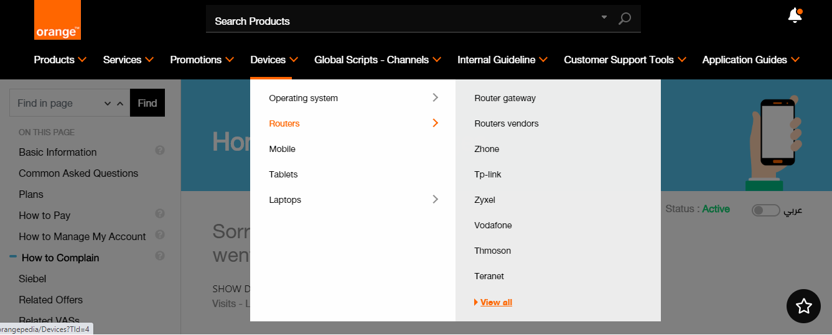

Slide 7
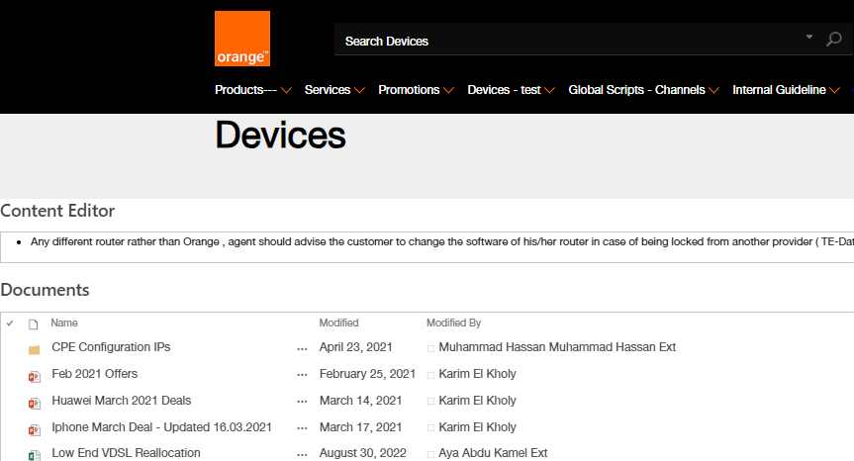


Slide 8
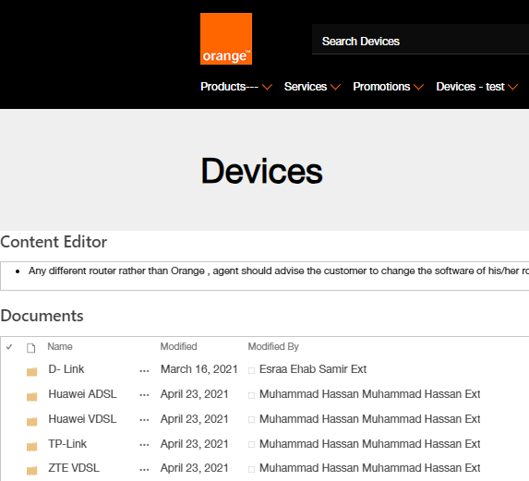


Slide 9
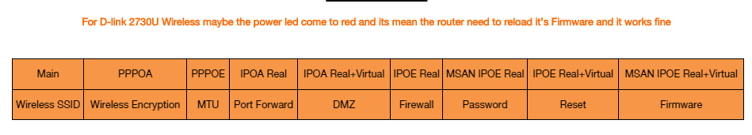
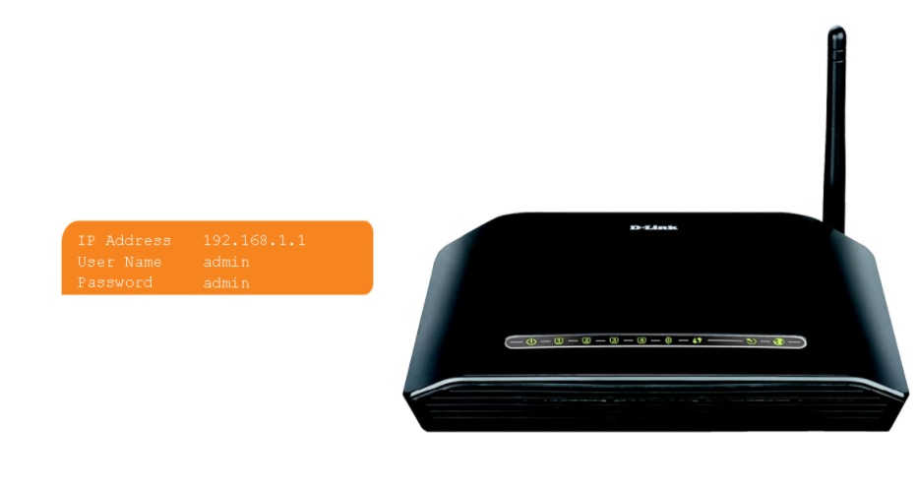
Please click here :

Slide 10
For MSAN customer
IPOE

Slide 11
Authentication

Slide 12
Authentication
General definition : customer line is physically up with no IP ( internet protocol )

Slide 13
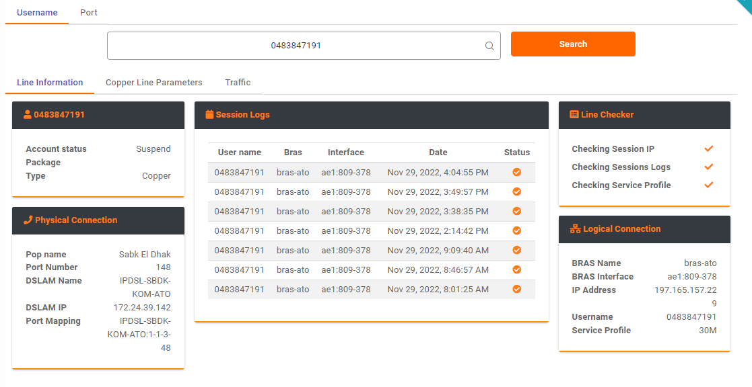
IP tool
OCTOPUS Tool

Slide 14
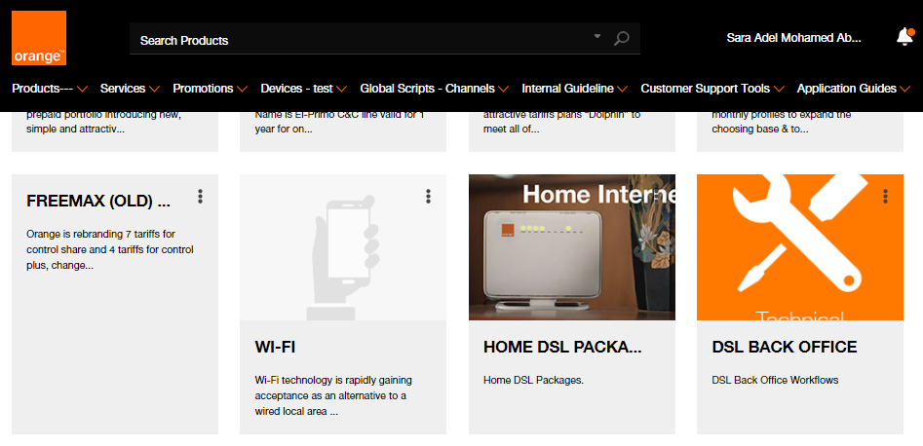

How to open Authentication WF

Slide 15
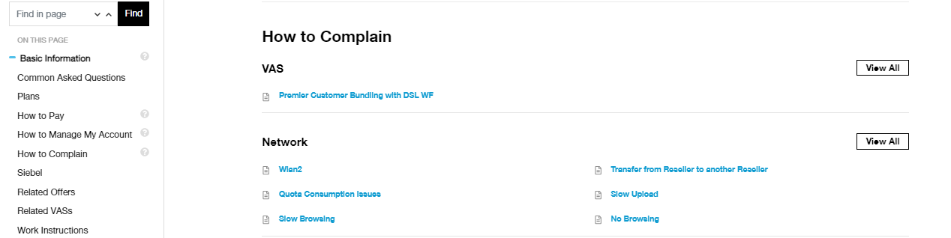


Authentication WF

Slide 16
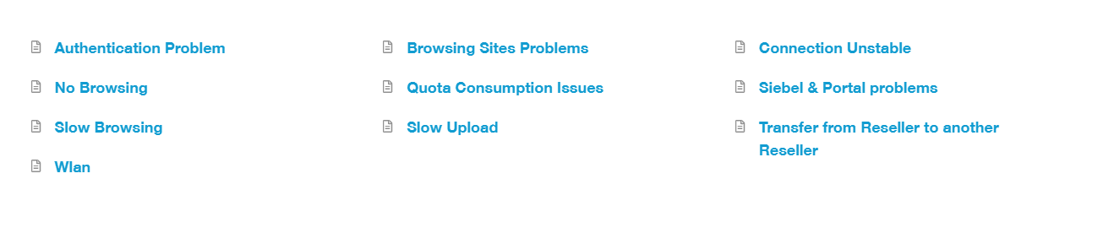
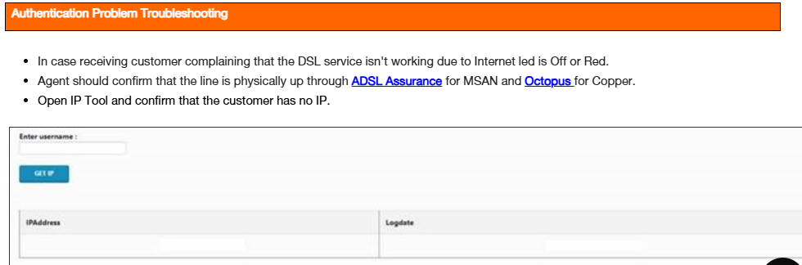
Authentication WF

Slide 17
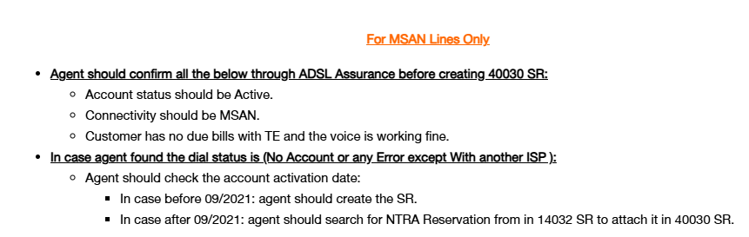
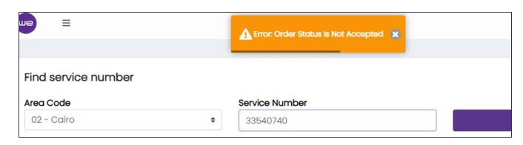

Slide 18
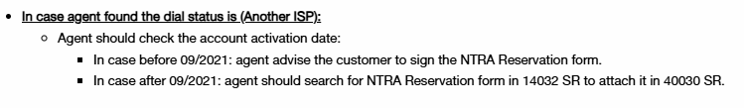
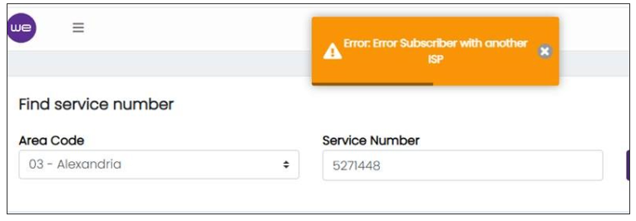

Slide 19
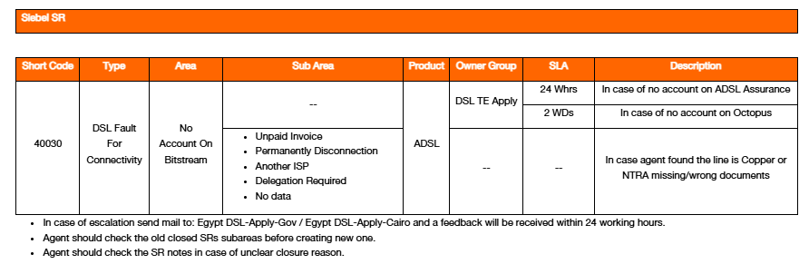

Slide 20
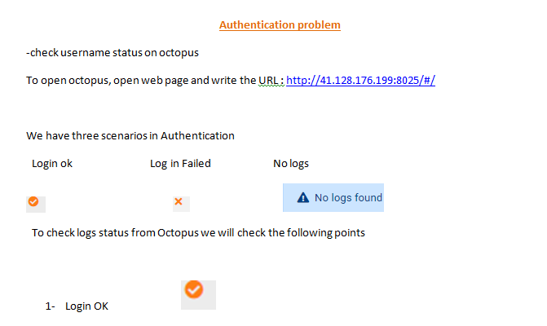
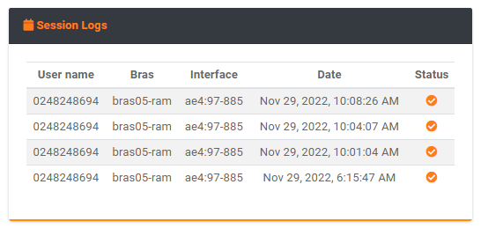
Notes:
Check OTCCT tool

Slide 21
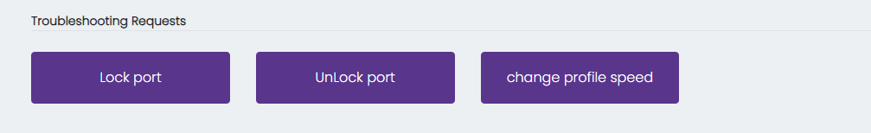
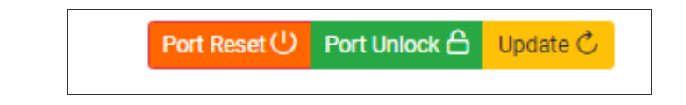
Reset the customer port via FTTH Tool or octopus. ​

Slide 22
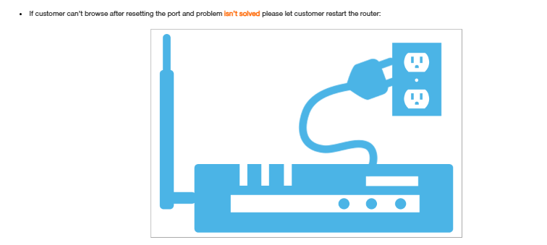

Slide 23
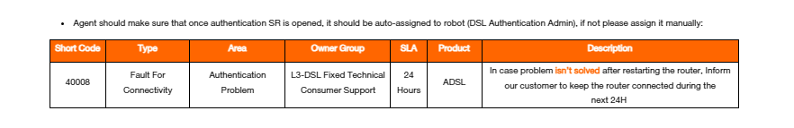
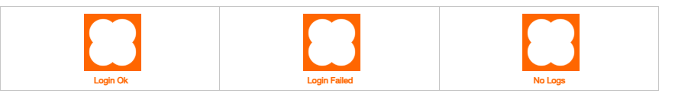
Open SR
تمام يااستاذ\ ة انا قدمت لحضرتك طلب والمشكلة هتكون اتحلت خلال ال 24 ساعه القادمة محتاج حضرتك تسيب الراوتر شغال ولو بعد 24 ساعه المشكلة لسه موجوده ممكن حضرتك تشرفنا بالاتصال مره تانية)

Slide 24
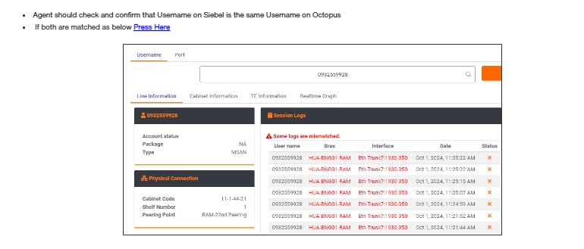
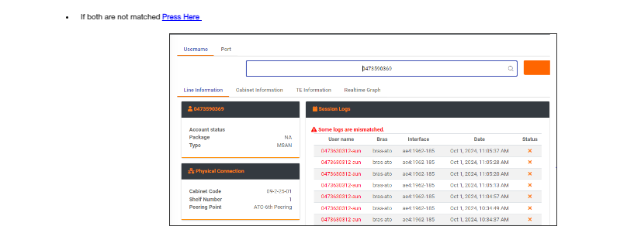
Notes:
في حاله ان العميل بيواجه مشكله Login Failed و ال Username مكتوب غلط علي ال OTCCT لازم ندخل علي صفحة الراوتر و نعدل ال username ولو مش عارفين ندخل علي صفحة الراوتر نعيد تعريفه من البداية .Reconfiguration في حاله انه صحيح و عنده مشكله login failed و ال Inner Vlan او ال Cabinet علي ال FTTH Toolمختلفة بالمقارنة بال OTCCT نكلم ال Assist Hunt .لو المشكلة لسه موجوده نعمل Authentication SR بصوره طبيعية ولو فيه مشكله فال Falcon ال Assist هيوضحلك تعمل ايه بناء علي المشكلة.

Slide 25
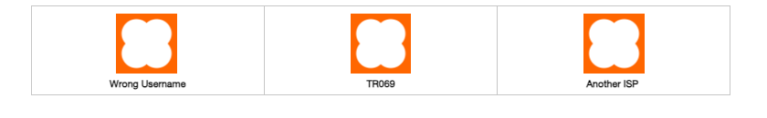
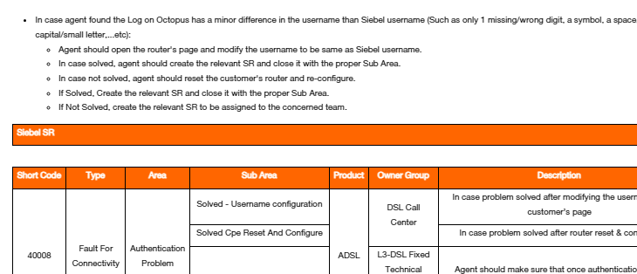
We should match the username on session logs with username on
Siebel

Slide 26
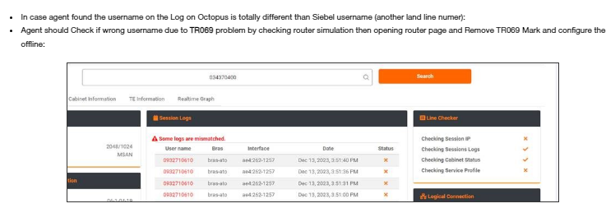
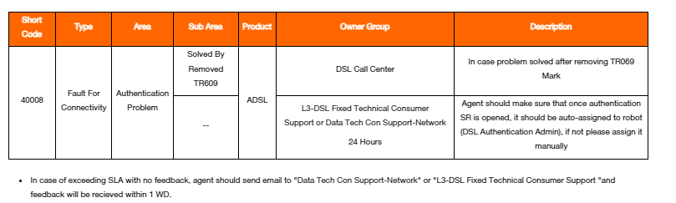

Slide 27
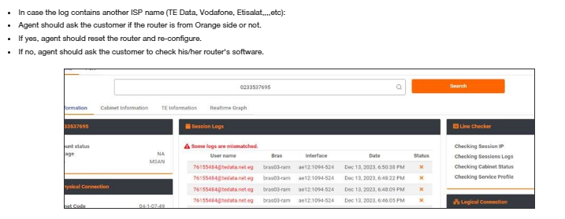
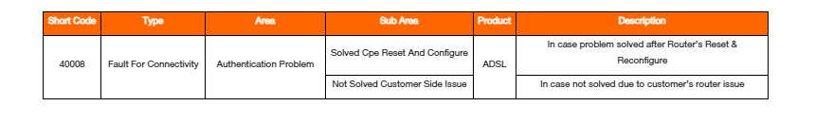

Slide 28
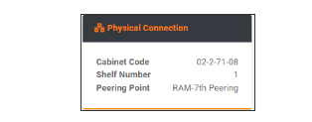
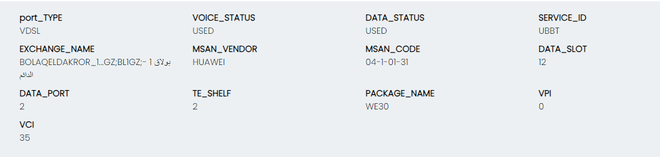
​​​​​​​​​​​​​​ In case customer has login failed with matched username, call assist hunt (08100) even if customer doesn't have Inner VLAN or Cabinet code mismatch to confirm that there is no mismatch on falcon as well.
Compare between Octopus​ & TE-Portal (Cabinet Code & Inner VLAN)
1-If Customer has Cabinet code Miss match
*OCTOPUS
*FTTH Tool

Slide 29
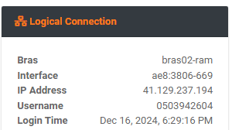
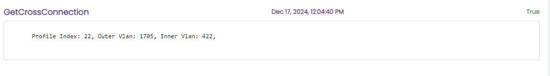

2- If Customer has Inner VLAN Mismatch
*OCTOPUS
*FTTH Tool

Slide 30
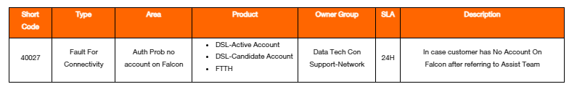
3- No Account on Falcon

Slide 31
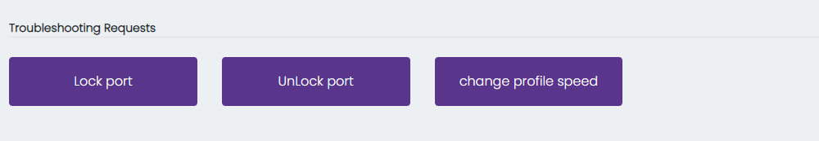
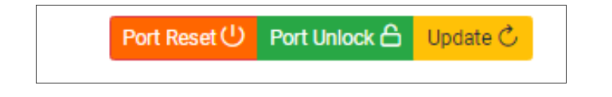
4- If customer hasn't problem in Cabinet Code or Inner VLAN

Slide 32
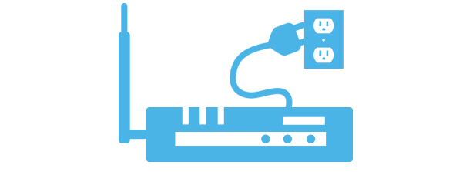
If customer can’t browse and problem isn’t solved so let customer restart the router

Slide 33
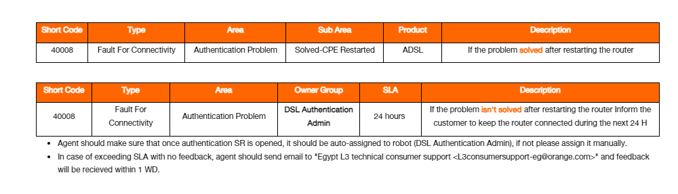
Open SR
تمام يااستاذ\ ة انا قدمت لحضرتك طلب والمشكلة هتكون اتحلت خلال ال 24 ساعه القادمة محتاج حضرتك تسيب الراوتر شغال ولو بعد 24 ساعه المشكلة لسه موجوده ممكن حضرتك تشرفنا بالاتصال مره تانية

Slide 34


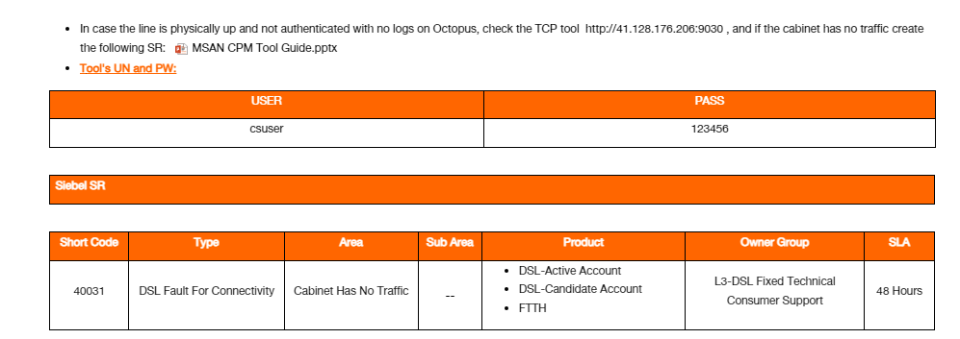

Slide 35
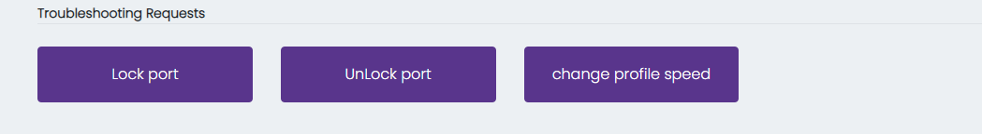
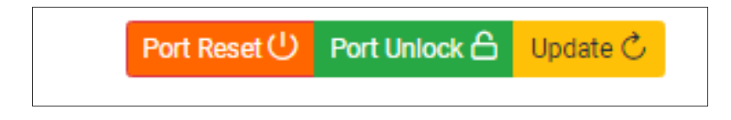
If the cabinet has traffic normally:
​Reset the customer port via TE Portal​ by pressing on "Lock port then Unlock port" ​​for MSAN Lines:

Slide 36
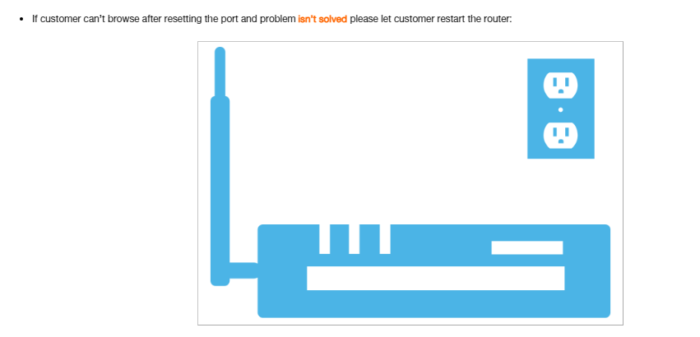

Slide 37
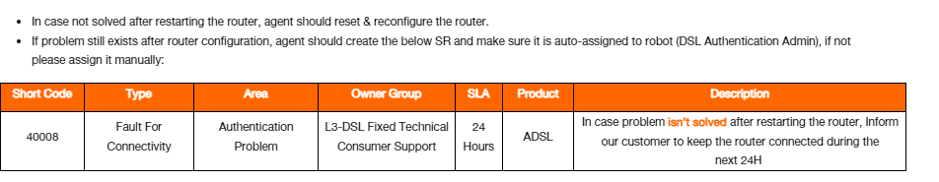
Open SR
تمام يااستاذ\ ة انا قدمت لحضرتك طلب والمشكلة هتكون اتحلت خلال ال 24 ساعه القادمة محتاج حضرتك تسيب الراوتر شغال ولو بعد 24 ساعه المشكلة لسه موجوده ممكن حضرتك تشرفنا بالاتصال مره تانية

Slide 38
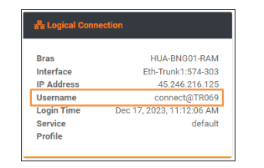
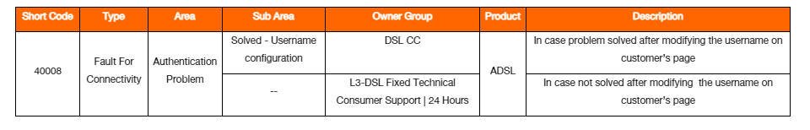
In case agent was checking the logical connection on Octopus and found the customer has "Connect Issue":
  Agent should open the router's page and modify the username to be same as Siebel username.
  In case solved​​​, agent ​should create the relevant SR and close it with the proper Sub Area.
  If Not Solved, create the relevant SR to be assigned to the concerned team.

Slide 39
No Browsing
That’s mean customer authenticated with IP ,all router leds are up with right light but he can’t browse all web sites .

Slide 40

How to open no browsing WF

Slide 41
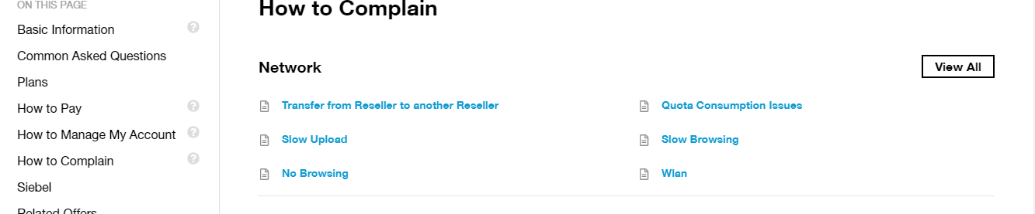
No Browsing WF

Slide 42
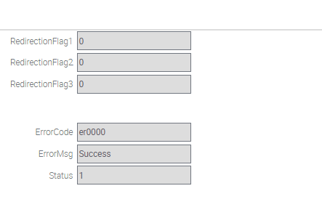
We have to confirm that line is up , authenticated and doesn’t have redirection page
Check IP on IP Tool as below
Check if there is any redirection page or not through Siebel as below
Notes:
Should check IP tool and PCRF ( QOS and redirection )

Slide 43
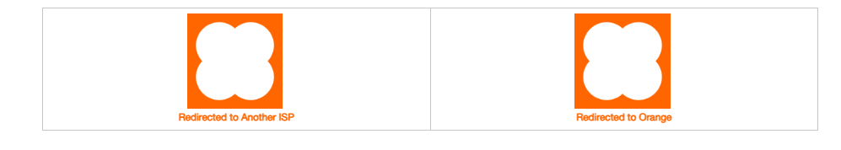
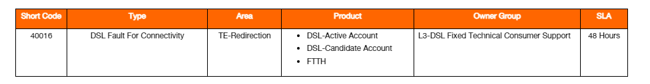
​​​Confirm that the line is physically up, stable & authenticated​​.
Advise the customer to open any browser and type this IP (172.217.23.100).
​
Check which page the customer is directed to:
انا واضح عندي يافندم ان في مشكلة فنية على خط حضرتك.
انا هقدم لحضرتك شكوى وهيتم التواصل مع حضرتك خلال 48 ساعه

Slide 44



Slide 45


Slide 46

If issue is solved after CPE restart

Slide 47


Slide 48



Check customer's QOS Profile through PCRF and Connected with IP through IP tool

Slide 49

If Customer can’t browse, Check customer services type Dynamic IP or 1 Static IP from SRs on Siebel:

Slide 50


Slide 51


Slide 52


Slide 53


Slide 54


Slide 55


Slide 56


Slide 57


Slide 58


If issue is solved after checking TCP/IP Setting create the below SR

Slide 59

Try to reset and Re-configure CPE​
You can check router simulation

Slide 60

If Issue is solved after reset and Re-configure CPE ,create the below SR

Slide 61

Script:
تمام يا أستاذ/ة....... أنا سجلت الطلب لحضرتك وفي خلال الـ24 ساعة اللي جاية فيه حد هيتواصل مع حضرتك من جانبنا لحل المشكلة ونستأذنك تسيب الراوتر شغال ​.​​​​​​
Short Code | 40013
Type | DSL Fault For Connectivity​
Area | No Browsing​
Product | ADSL
Owner Group | Data Tech Con Support-Network
Sub Area | Empty​
Status | Open
Smart Script | Yes​
SLA | 24 H​​

Slide 62


In case customer has no browsing while using mobile and doesn’t have PC

Slide 63




If issue is still existed

Slide 64
Script:
تمام يا استاذ/ة...... انا قدمت طلب لحضرتك وفي خلال ال 24 ساعه اللي جايه هيتم التواصل مع حضرتك من جانبنا لحل المشكلة الفنية
Short Code | 40013
Type | DSL Fault For Connectivity​
Area | No Browsing​
Product | ADSL
Owner Group | Data Tech Con Support-Network
Sub Area | Empty​
Status | Open
Smart Script | Yes​
SLA | 24 H​​

Slide 65



Slide 66


If Matched, we will continue the same previous WF steps from the below point
If not Matched

Slide 67

Script
تمام يااستاذ\ ة انا قدمت لحضرتك طلب والمشكله هتكون اتحلت خلال ال 24 ساعه القادمه محتاج حضرتك تسيب الراوتر شغال ولو بعد 24 ىساعه المشكله لسه موجوده ممكن حضرتك تشرفنا بالاتصال مره تانيه
​

Slide 68
Check customer's QOS Profile through PCRF and Connected with IP through IP tool

Slide 69


Slide 70
Check customer's QOS Profile through PCRF and Connected with IP through IP tool

Slide 71
Redirection Page

Slide 72




Slide 73
​List of redirections that the action will be taken through SRs:
  Redirection Activation: Related SR (3102)
  Redirection Suspension: Related SR (3104)
  Redirection No payment: Related SR (3100)
  Redirection Unknown : Related SR (3101 )
  Redirection Cancelation: Related SR (3103)​
​​Important Notes:
  In case of Active Account: SR should be assigned to DSL CH VAS​.
  In case of Candidate Account: SR should be assigned to DSL Installation Team as below 2 scenarios:
    New activation.
    Change user name or connectivity.​
Redirect_Activation :
  Check if the customer has ( New Activation order ) , check if the self installation task is still pending , configure the CPE with customer and then activate the service via ( aa.com ) ( 172.217.23.110 )​, or (74.125.133.113 ) by asking the customer to press on activate option and if he already configured his CPE proceed on activation step , finally recheck if self installation task is closed automatically or not , call Assist Hunt to close if customer did all these steps and Order is completed but still has redirect activation Create SR (3102)

Slide 74
Redirect_Suspension ​:
If the customer has Voluntary Suspension order ​ ​​>> Advise him how to reactivate the Service
If the Customer has Modify Service order ​>> Check the pending Task and handle it
If the Customer doesn't have Pending order , Create SR (3104)
Redirect​ No Payment :
In case of receiving customer's complaint from “No browsing" issue and after checking agent found that account has due amount.
Agent should check if the customer has due bill and exceeded the grace period or not.
If yes, Advise the customer to pay his/her due amount and Create Release Line SR if eligible (promise to pay).
If no, and still has redirect No Payment ,OR , if release line SR is submitted​ but still has redirect No payment create the below relevant SR "3100".

Slide 75
Redirect​ Cancellation :
Check if the customer has "Deactivate Service Request", if yes, follow cancellation WF.
If No, or there is "Deactivate Service Request" and its status is cancelled but customer still has redirect cancellation , create the below relevant SR “3103”.
Redirect​ Unknown_User :
Redirection Unknown User only happens in one of the below scenarios:
  New Activation request.
  Change Username request.
Accordingly, agent should ensure that customer is configured with the same username as Siebel (compare the username which exists on Octopus Log with
Siebel Username) and if not modify it from router’s page.
If username is correct , create the below relevant SR “3101”.

Slide 76
Slow Download

Slide 77


How to open Slow Download WF

Slide 78


Slide 79
Slow Download could be considered as Physical or network issue
*For MSAN (check from TE-Portal)
Check first pervious SRs and related comments to avoid wrong SR .
Bad line in MSAN to considered bad if the MAX is less 36 maintaining that the port and router are VDSL.
Bad line is considered if line is less than 15 M for customers with ADSL port or ADSL router.​
For Copper (check from Octopus​)
  Relative Occupation : < 85%
  Noise Margin : > 60 dB
  Signal Att : < 350 dB
  Bitrate : < 85% from the Max rate
  Max att : > 6144 kb/s​
It is considered as network issue if the parameters are good so if customer has problem in QOS , Bit rate , or if every thing is ok but he still has slow , it will be handled as network issue
Physical issues requires to check , splitter wiring , internal wiring , Box and cabinet to be solved
We must make sure that customer didn’t consume all his Quota and his speed isn’t downgraded to 256 K
We must make sure that customer got right QOS matched with his speed

Slide 80
QOS
Check customer’s quota consumption through Siebel PCRF as shown below if the package is fully consumed or not.
If not fully consumed, follow the below troubleshooting steps.
If fully consumed, offer upgrading the package/adding extension using the below script and create & close the below SR.

Slide 81



Normal QOS

Slide 82




Slide 83



Slide 84
- Check customer quota consumption and make sure that he didn’t consume all his Quota​
Notes:
PCRF

Slide 85


Check line parameters to determine if they are good or not
For copper we will check parameters through OCTOPUS

Slide 86

For MSAN through FTTH Tool

Slide 87



Slide 88


* For Copper
*For MSAN

Slide 89


Slide 90



Slide 91
Open SR
تمام يا أستاذ/ة....... أنا سجلت طلب حضرتك وفى حد من الدعم الفني هيتابع الشكوى، بستأذن حضرتك نسيب الراوتر متوصل، ولو مفيش أي تأخير من المصرية للاتصالات في خلال 48 ساعة عمل هتكون الخدمة شغاله بصوره طبيعية عند حضرتك
Sort code 39013
Type DSL Fault For Physical
Area Bad Line
Product ADSL
Smart Script Yes
Owner Group Data Tech Con Support-Physical
Sub Area Empty
Status Open
SLA 48 WH

Slide 92
To determine if customer has bitrate Mismatch or not check the following :
Relative Occupation should be less than 85% ( Relative Occupation = Current Rate / Max attainable Rate )
Example 1 :
If the Max Attainable Rate is 20480 , the Bitrate should be less than 85% from 20480 (Current Rate 16384)
We will divide Current Rate / Max Attainable Rate ) 16384/20480 = 80 % >>> doesn't have Bit rate Mismatch
Example 2:
If the Max Attainable Rate is 20480 , the Bitrate should be less than 85% from 20480 (Current Rate 10240)
We will divide Current Rate / Max Attainable Rate ) 10240/20480 = 50% >>> has Bit rate Mismatch​

Slide 93



If parameters are good , Check Bit Rate on OCTOPUS for copper or FTTH Tool for MSAN
Notes:
And check QOS on PCRF

Slide 94

For Copper :
For MSAN :

Slide 95



Slide 96
Check Bit Rate on OTCCT for copper or FTTH Tool for MSAN

Slide 97




Notes:
Copy the DSLAM Name from OTCCT ( check tool guide )

Slide 98




Slide 99

​​​•​​In case customer is facing a slowness for any gaming consoles, agent should follow Online Gaming Handling.
In case customer is facing a slowness related to (computers & mobiles) devices, we will follow the below handling:​
Agent will guid​e the customer to open http://www.speedtest.net/.
Ask customer to connect the device with LAN if available.
If not, ask customer to connect through Wi-Fi with 1 device only and disconnect all the others . ​
Check speed test result and compare it with customer’s speed with minimum accepted download speed.
Notes:
في حاله ان العميل عنده مشكلة بطء في السرعة وكل القرايات علي السيستم سليمه و عنده جيجات متاحه ( (Quota بنخلي العميل يفتح www.speedtest.net لو علي موبايل هيطلب منه ينزل application بضغط علي GO وبعدها يبيدا يظهر معدل التنزيل و التحميل عند العميل. بتأكد ان معدل السرعة اللي ظاهر للعميل يساوي او اكثر من 65% من ال current rate مش من سرعة العميل لان دي سرعات تصل الي علي حسب كفاءة الخط.
لو العميل نحاس اللي ظاهر للعميل يساوي او اكثر من 45% من ال current rate.

Slide 100


Slide 101

​In case both minimum speed download rate and speed test results are matched:
  Agent will inform the customer that no problem found.
In case speed download rate is not matched with speed test results:
  A complaint will be submitted.
In case customer refused the Speed Test troubleshooting or wasn't convinced with the Speed Test result:
  ​Agent will follow the normal handling “trusted sites" to test the download rate by informing the customer to download files from trusted sites therefore s/he can compare his/her download rate with the speed test rate.
​Example:
  If the customer's line profile through TE Portal is 16 Mbps, make a speed test and get the accepted rate by applying the below calculation:
  (16384x0.65=10.4)
  If customer refused the speed test troubleshooting or wasn't convinced with the speed test result, agent will follow the normal handling “trusted sites” to test the download rate by (16384x0.65/8).
  If the result is 1331.2 KB/Sec, then it’s accepted.
  If the result is less than 1331.2 KB/Sec, then it's not accepted.

Slide 102


​​​

Slide 103



Slide 104

​​- Create SR (SLA 24 H)​

Slide 105
•​​In case customer is facing a slowness for any gaming consoles, agent should follow Online Gaming Handling.
In case customer is facing a slowness related to (computers & mobiles) devices, we will follow the below handling:​
Agent will guid​e the customer to open http://www.speedtest.net/.
Ask customer to connect the device with LAN if available.
If not, ask customer to connect through Wi-Fi with 1 device only and disconnect all the others . ​
Check speed test result and compare it with customer’s speed with minimum accepted download speed.

Slide 107
In case both minimum speed download rate and speed test results are matched:
  Agent will inform the customer that no problem found.
In case speed download rate is not matched with speed test results:
  A complaint will be submitted.
In case customer refused the Speed Test troubleshooting or wasn't convinced with the Speed Test result:
  ​Agent will follow the normal handling “trusted sites" to test the download rate by informing the customer to download files from trusted sites therefore s/he can compare his/her download rate with the speed test rate.
Example:
  If the customer's line profile through TE Portal is 16 Mbps, make a speed test and get the accepted rate by applying the below calculation:
  (16384x0.65=10.4)
  If customer refused the speed test troubleshooting or wasn't convinced with the speed test result, agent will follow the normal handling “trusted sites” to test the download rate by (16384x0.65/8).
  If the result is 1331.2 KB/Sec, then it’s accepted.
  If the result is less than 1331.2 KB/Sec, then it's not accepted.

Slide 109
​​- Create SR (SLA 24 H)​

Slide 110
Slow Upload
Slow Upload could be considered as Physical or network issue.

Slide 111


How to Open Slow Upload WF

Slide 112

1
2

Slide 113


Slide 114


Check Physical Line parameters from OCTOPUS for copper ​​

Slide 115


Check Physical Line parameters from FTTH Tool for MSAN
We should check Maximum attainable Rate US ​​

Slide 116

For Copper :
For MSAN :

Slide 117



Slide 118



Slide 119


Slide 120


Compare between Bit Rate and Max Attainable rate , Bit Rate should be 65% of Max Attainable Rate ​

Slide 121
For Copper :
For MSAN :

Slide 122
Open SR
Script
تمام يااستاذ\ ة انا قدمت لحضرتك طلب والمشكلة هتكون اتحلت خلال ال 24 ساعه القادمة محتاج حضرتك تسيب الراوتر شغال ولو بعد 24 ساعه المشكلة لسه موجوده ممكن حضرتك تشرفنا بالاتصال مره تانيه
Create the below SR & Clarify in SR Note that customer has bit rate mismatch regarding upload speed

Slide 123


Slide 124

​Check customer's package and calculate the accepted upload rate which should be 65% of the current rate.
Incase receiving customers subscribed on Up to 30 packages and complaining from his/her upload speed and the reason to be 1 Mbps and instead of 3 Mbps , use the below Script.

Slide 125


Open SR
Script
تمام يااستاذ\ ة انا قدمت لحضرتك طلب والمشكلة هتكون اتحلت خلال ال 24 ساعه القادمة محتاج حضرتك تسيب الراوتر شغال ولو بعد 24 ساعه المشكلة لسه موجوده ممكن حضرتك تشرفنا بالاتصال مره تانيه

Slide 126
Slow Browsing
Please check customer quota consumption and make sure that he didn’t consume all his usage first before handle slow workflow
Slow browsing could be considered as Physical or network issue.

Slide 127

How to Open Slow Browsing WF

Slide 128

1
2

Slide 129



Slide 130

Before checking Slow browsing we should make sure download rate is accepted
- Use Slow Download Work Flow in case download rate is not accepted ​.
Notes:
Check the customer parameters from your side

Slide 131

Please check customer quota consumption and make sure that he didn’t consume all his usage first before handle slow workflow.
Check Physical Line parameters from Octopus ​for copper.

Slide 132



Slide 133

Reset the customer’s Browser and check the browsing again, steps will be according to browser type
​Click the Tools "menu".
Select Options.
Click the Under the Hood tab then click on "Clear browsing data" button
Select "the beginning of time" , Mark the needed checkboxes and click "Clear browsing data" button
Click on "Under the Hood" again then click on "Change proxy settings" button
Select Connections tab and make sure the Dial-up Box is Empty then click "LAN settings" button then click "OK" button
Make sure to clear check boxes then click ok

Slide 134




Slide 135




​​Change the MTU on the customer Modem to 1420
If not solved, agent can try 1300 or 1380 (As an extra mile and not a mandatory step).​
Check Browsing Speed again. ​

Slide 136

Open SR
In case customer using smart phone, open case with the below details and inform him/her to prepare a device connected with cable or WiFi if possible for follow up call.
Inform the customer to keep the CPE connected during the next 24 Hrs.
tScript
​تمام يا أستاذ/ة....... أنا سجلت الطلب وبستأذن حضرتك نسيب الراوتر متوصل وفي خلال الـ 24 ساعه اللي جاية هتكون الخدمة شغالة بصورة طبيعية وفى حاله ان حضرتك واجهت نفس المشكله بعد 24 ساعه ممكن تعاود الاتصال بينا مرة تانية
​​In case of exceeding the SLA:​
​​هقدم لحضرتك طلب استعجال وهيتم الرد في اسرع وقت ممكن.. شكرا لتفهمك ​
​

Slide 137



Slide 138
* For Copper
*For MSAN

Slide 139
- If the customer is calling from DSL service number:
• Ask the customer for his/her mobile number
• Ask customer to end call with you and ask him to answer the call on his/her mobile.
• Put Not Ready
• Call the customer
• Connect with him/her without splitter

Slide 140

Open SR
تمام يا أستاذ/ة....... أنا سجلت طلب حضرتك وفى حد من الدعم الفني هيتابع الشكوى، بستأذن حضرتك نسيب الراوتر متوصل، ولو مفيش أي تأخير من المصرية للاتصالات في خلال 48 ساعة عمل هتكون الخدمة شغاله بصوره طبيعية عند حضرتك

Slide 141
Connection Unstable
Not matched physical with logical up time on FTTH Tool & IP Tool
Notes:
Connection Unstable Means: the customer has instability connectively (the customer get IP and change it without restarting the router.

Slide 142

How to Open Connection unstable WF

Slide 143



1.​​Open FTTH Tool and check the Port Up time.
2.Open IP Tool and check the login date.

Slide 144


3. If both not matched (the time between port up time & IP and found more than 5 minutes) will assign "40012" Siebel SR to L3 --> Agent shouldn’t do port reset or restart the router​.
Notes:
If matched Follow line unstable WF.

Slide 145


For Copper
IP Tool

Slide 146


3. If both not matched (the time between port up time & IP and found more than 5 minutes) will assign "40012" Siebel SR to L3 --> Agent shouldn’t do port reset or restart the router​.
Open SR

Slide 147
Browsing Sites Problem
In case receiving customer complaining from sites problem.
Notes:
Browsing sites Problem means: the customer can use internet normally except specific web site or sites

Slide 148

Customer should have a PC/Laptop in order to follow this handling.
If no and customer only has a mobile, accordingly agent should make sure that the customer is connected (Authenticated and has IP) and date & time is updated.
Agent should create & close the below SR:

Slide 149


In case can browse other websites, agent should ask the customer If s/he installed a firewall/ ISA server.
If Yes, ask the customer to connect back to back and make sure the default GW for his/her PC/Laptop is router IP (not ISA server IP).
If No, follow the below:​

Slide 150


Slide 151


- Reset browser settings to default
Let Customer try to open the web site​

Slide 152



- Check DNS , on TCP/IP Setting​
- Preferred DNS 41.128.225.225
- Alternate DNS 41.128.225.226
1
2
3

Slide 153


4
5

Slide 154


6
Let customer try to open the web site​

Slide 155




Slide 156


Script
تمام يا أستاذ/ة....... أنا سجلت الطلب لحضرتك وفي خلال الـ24 ساعة اللي جاية فيه حد هيتواصل مع حضرتك من جانبنا لحل المشكلة ونستأذنك تسيب الراوتر شغال ​.

Slide 157
WLAN
Wireless LAN that uses to link more devices using wireless communication from a local area network within limited area.

Slide 158


How to Open WLAN WF

Slide 159

1
2

Slide 160


  How to check if Wireless Installed driver card is installed on windows 10:
    Start button
    Settings
    Network & Internet
    Status
    Network and Sharing Center
    Click on change adapter settings it'll direct you to network connections.
    You notice Wi-Fi icon, if not found that means Wireless network adapter is not installed.
How to check if Wireless Installed driver card is installed on windows 8:​
  ​​From the start menu click on "Desktop" icon

Slide 161


Slide 162


Slide 163


Slide 164



Installed
Not Installed
Wireless Network Card not installed

Slide 165



Installed
Not Installed

Slide 166




Slide 167


Slide 168


Slide 169


Slide 170



Slide 171


Slide 172



Slide 173


Slide 174


Slide 175



Slide 176



Slide 177


Slide 178


Slide 179


Slide 180



Slide 181



Slide 182


Slide 184



Slide 185


Slide 186


Slide 190


Slide 191


Slide 195


Slide 197


Slide 198



Slide 200
(Customer couldn’t find network The same steps Follow WF customer found his network

Slide 201


Slide 202


Slide 203


Slide 204


Slide 205


Slide 206


Slide 207


That’s mean there is PC problem

Slide 208


Slide 209



Slide 210


Slide 211


Slide 220
Quota Problems

Slide 221


Notes:
Check PCRF

Slide 222

How to Open Quota Consumption Issues WF

Slide 223



Slide 224

No limitation for recharging quota, Our customer can recharge unlimited count of quota.
Extra validity is 1 month.​
Recharge options are (16333 & shops & portal ) available for all customer base including GOV customer.

Slide 225



Check customer balance and his renewal date for his quota (Quota Renewal date = Due Date for invoices)
-Renewal takes place from 12:00 AM till 3:00AM , accordingly no need for escalation during this time.​

Slide 226



​

Slide 227



Slide 228



Slide 229
Open SR
تمام يا أستاذ/ة....... أنا سجلت الطلب لحضرتك وفي خلال الـ48 ساعة اللي جاية هنقوم بحل مشكلة حضرتك، وفى حاله ان حضرتك واجهت نفس المشكلة بعد 48 ساعه ممكن تعاود الاتصال بينا مرة تانية
Short Code | 37014
Type | Fault For VAS
Area | Quota Renewal Problem
Product | ADSL
Owner Group | DSL CH VAS​
Sub Area | Empty
Status | Open
Smart Script | Yes

Slide 231


- Customer complains that he charged (Online or shop or 16333) but he didn’t get extra quota for charging Extra Quota problems through 16333 for charging Extra Quota problems through 16333 Click here​
2
1
- Check on PGW (Payment Gateway) if transaction done successfully.

Slide 232

Customer complains that he charged (Online or shop or 16333) but he didn’t get extra quota
- Check on PGW (Payment Gateway) if transaction done successfully

Slide 233

If Transaction done successfully on PGW (Payment Gateway ​and Pay Station), Check Quota on PCRF, if still not updated:
In case customer added extra quota through IVR/Portal/My Orange App but it's duplicated in PCRF Or:
In case customer added 1 or more extra quota by mistake and complained from non-usage due to the new validity or any other reason:
  ​Agent should validate and confirm customer 0 consumption of the claimed extra quota through PCRF.
  ​Agent should create "37021" SR to be assigned to CH Billing​ in order to assign the SR to IT DSL team to remove the extra added Quota from PCRF.
  Then CH Billing agent should adjust the customer's balance accordingly including the VAT.

Slide 234


Slide 235
Make sure to fill the below data in the Smart Script:
Last 4 digits from credit card
Amount
Transaction date
Channel ( my orange App or through portal)
Add note: it is for bill payment or purchasing extra quota
Number used for access the application
Contact number​
Note : Don't forget to attach the reference from PGW in the SR .
Don't open the SR before passing 24 hours from extra quota purchasing date.
Taking into consideration that in case customer purchased the extra quota from shop, the payment receipt should be attached.
Make sure to mention all the payment details within the Smart script.

Slide 236


Slide 237


Slide 238

-This Scenario occurs when quota consumption doesn't count (consumption not updated)
- Check PCRF and verify
we Will notice that there is normal usage appears in the daily usage on PCRF while remaining quota isn’t decreased

Slide 239
Open SR
تمام يا أستاذ/ة....... أنا سجلت الطلب لحضرتك وفي خلال الـ48 ساعة اللي جاية هنقوم بحل مشكلة حضرتك، وفى حاله ان حضرتك واجهت نفس المشكلة بعد 48 ساعه ممكن تعاود الاتصال بينا مرة تانية
Short Code | 37004
Type | Fault For VAS
Area | Quota Dispute
Product | Choose Customer's package​
Owner Group | DSL CH VAS​
Sub Area | Empty
Status | Open
Smart Script | Yes
-This Scenario occurs when quota consumption doesn't count (consumption not updated)
- Check PCRF and verify​, if the error found:

Slide 240


-This Scenario occurs when quota consumption doesn't count (consumption not updated)
- Check PCRF and verify​, if there's no error close the below SR .
​

Slide 241
Online Gaming support
Could be considered as Physical or network issue.

Slide 242
How to Open Quota Consumption Issues WF

Slide 243



Slide 244



Slide 245



Slide 246

Thank you
Thank you

